Slide 1
Chương 1: Giới thiệu về CSDL Không gian
1.1 SDBMS là gì?
1.2 So sánh SDBMS với GIS
1.3 Ví dụ ứng dụng SDBMS
1.4 How is a SDBMS different from a GIS ?
1.5. Các thuật ngữ GIS
1.6. Thành phầm SDBMS
1.7. Kiến trúc của SDBMS

Slide 2

Giá trị của SDBMS
Hệ quản trị cơ sở dữ liệu truyền thống (non-spatial) có khả năng:
  Cho phép truy vấn đồng thời vào dữ liệu
  Khả năng mở rộng cho phép truy vấn trên tập dữ liệu lớn.
  Hiệu quả cho truy vấn phi không gian, nhưng không hỗ trợ truy vấn không gian
Truy vấn phi không gian (Non-spatial queries):
  Liệt kê tên của tất cả các quầy sách có nhiều hơn 10.000 đầu sách
  Liệt kê tên tất cả các khách hàng đã mua sách trong năm 2001.
Truy vấn không gian (Spatial Queries):
  Liệt kê tên tất cả các quầy sách các Minneapolis 10 dặm
  Liệt kê tất cả các khách hàng sống tại Tennessee và các ban lận cận đó.
Notes:
Persistence across failures

Slide 3
Giá trị của SDBMS – Spatial Data Examples
Examples of non-spatial data
  Names, phone numbers, email addresses of people
Examples of Spatial data
  NASA satellites imagery - terabytes of data per day
  Weather and Climate Data
  Rivers, Farms, ecological impact
  Medical Imaging
  …

Slide 4
1.1. SDBMS là gì?
SDBMS: Spatial Database Management System
* Là một cơ sở dữ liệu
Là một DBMS có bổ sung thêm thành phần xử lý dữ liệu không gian.
* Có định nghĩa các kiểu dữ liệu không gian (spatial data types -SDTs) trong mô hình dữ liệu và ngôn ngữ truy vấn.
Cấu trúc dữ liệu không gian: POINT, LINE, REGION
  Quan hệ không gian: (l intersects r)

Slide 5

Standard Database
Has data types
  varchar
  integer
  real
  date

Slide 6
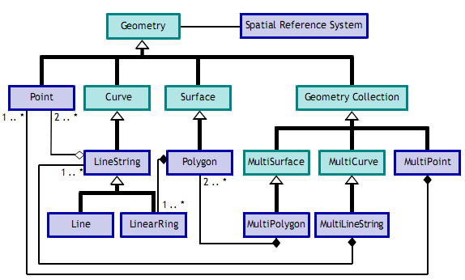
Spatial Database
Spatial data types
  point
  linestring
  polygon
  multipoint
  multilinestring
  multipolygon

Slide 7
1.1. SDBMS là gì?
* Hỗ trợ SDT trong lập trình (implementation)
- Cung cấp chỉ số không gian (spatial indexing): retrieving objects in particular area without scanning the whole space
- Cung cấp thuật toán liên kết không gian (spatial joins): not simply filtering the cartesian product.

Slide 8
1.2. So sánh SDBMS và DBMS
DBMS
SDBMS
Lưu trữ dữ liệu phi không gian
Không lưu trữ dữ liệu không gian
Truy vấn dữ liệu phi không gian
Không truy vấn dữ liệu không gian
Lưu trữ dữ liệu phi không gian
Lưu trữ dữ liệu không gian
Hỗ trợ truy vấn phi không gian
Hỗ trợ truy vấn không gian

Slide 9
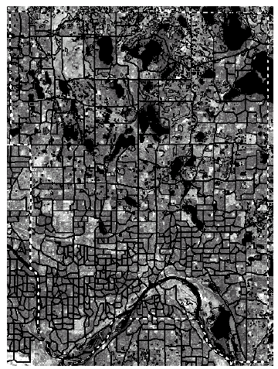
1.3. Ví dụ SDBMS
Consider a spatial dataset with:
  Census block - name, area, population, boundary (dark line)
Storage in a SDBMS table:
create table census_blocks (
name string,
area float,
population number,
boundary polygon );
Fig 1.2

Slide 10
Modeling Spatial Data in Traditional DBMS
A row in the table census_blocks (Figure 1.3)
Question: Is Polygon datatype supported in DBMS?
Figure 1.3

Slide 11
Spatial Data Types and Traditional Databases
Traditional relational DBMS
  Support simple data types, e.g. number, strings, date
  Modeling Spatial data types is tedious
Example: Figure 1.4 shows modeling of polygon using numbers
  Three new tables: polygon, edge, points
    Note: Polygon is a polyline where last point and first point are same
  A simple unit square represented as 16 rows across 3 tables
  Simple spatial operators, e.g. area(), require joining tables
  Tedious and computationally inefficient

Slide 12
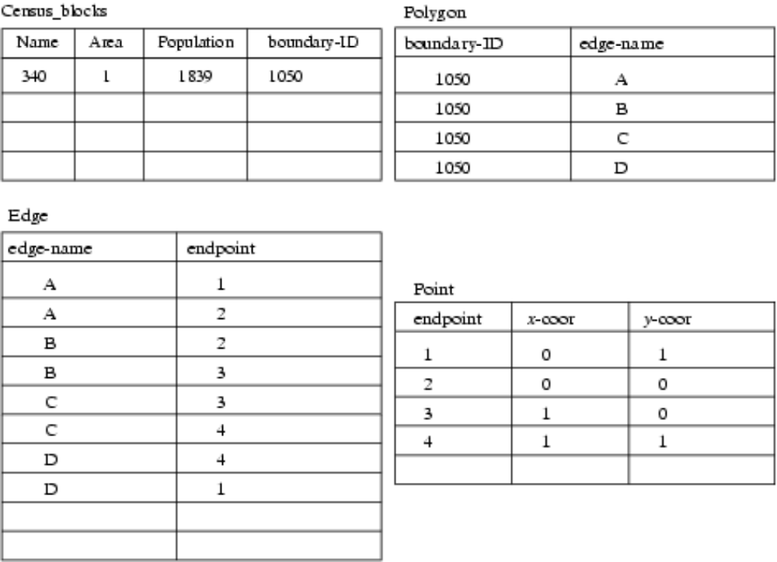
Ánh xạ “census_table” vào CSDL quan hệ
Fig 1.4

Slide 13

1.4. How is a SDBMS different from a GIS ?
GIS là một công cụ/phần mềm dùng để hiển thị, phân tích dữ liệu không gian sử dụng các chức năng phân tích không gian.
  Search Thematic search, search by region, (re-)classification
  Location analysis Buffer, overlay,…
  Terrain analysis Slope/aspect, catchment, drainage network
  Flow analysis Connectivity, shortest path
  Distribution Change detection, proximity, nearest neighbor
  Spatial analysis/Statistics Pattern, centrality, autocorrelation, indices of similarity, topology: hole description
  Measurements Distance, perimeter, shape, adjacency, direction
GIS dùng SDBMS để lưu trữ, tìm kiếm, truy vấn, chia sẻ dữ liệu không gian
Notes:
GIS: Geographic Information Systems
corridor,

Slide 14
1.4. How is a SDBMS different from a GIS ?
SDBMS focusses on
  Efficient storage, querying, sharing of large spatial datasets
  Provides simpler set based query operations
  Example operations: search by region, overlay, nearest neighbor, distance, adjacency, perimeter etc.
  Uses spatial indices and query optimization to speedup queries over large spatial datasets.
SDBMS may be used by applications other than GIS
Will one use a GIS or a SDBM to answer the following:
  How many neighboring countries does USA have?
  Which country has highest number of neighbors?
Notes:
GIS: Geographic Information Systems

Slide 15
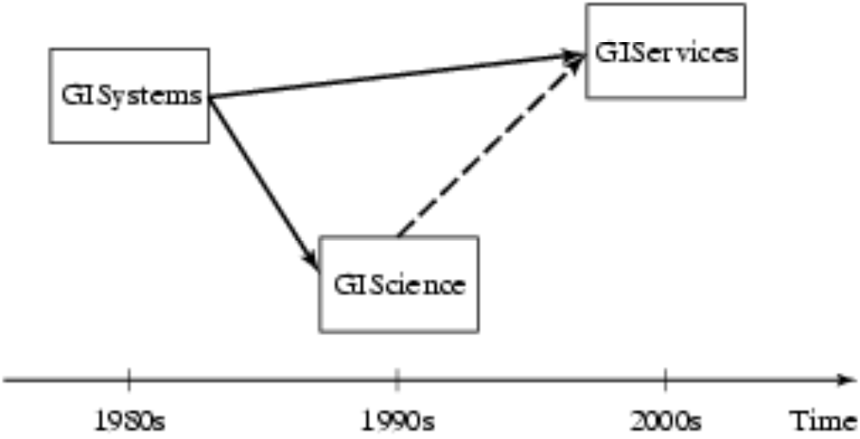
1.5. Các thuật ngữ “GIS”
Geographic Information Systems (1980s)
Geographic Information Science (1990s)
Geographic Information Services (2000s)
Fig 1.1

Slide 16
Three meanings of the acronym GIS
Geographic Information Services
  Web-sites and service centers for casual users, e.g. travelers
  Example: www.vietbando.com, www.adagps.com; …
Geographic Information Systems
  Software for professional users, e.g. cartographers
  Example: ESRI Arc/View software, Open Source software (uDig, gvSIG, GRASS, MapWindow,…)
Geographic Information Science
  Concepts, frameworks, theories to formalize use and development of geographic information systems and services
  Example: design spatial data types and operations for querying

Slide 17
1.6. Các thành phần của SDBMS
Recall: a SDBMS is a software module that
  can work with an underlying DBMS
  supports spatial data models, spatial ADTs and a query language from which these ADTs are callable
  supports spatial indexing, algorithms for processing spatial operations, and domain specific rules for query optimization
Các thành phần của SDBMS gồm:
  Mô hình dữ liệu không gian, kiểu dữ liệu không gian, tổ chức file và chỉ mục, tối ưu hóa truy vấn,… (spatial data model, spatial data types, file organization and indices, query optimization, etc.).

Slide 18
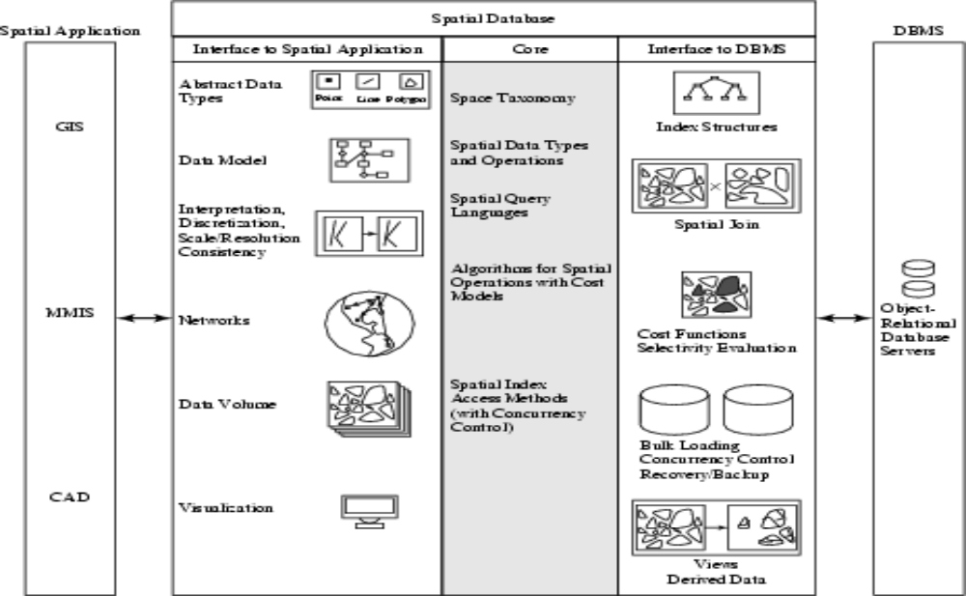
Three Layer Architecture
Fig 1.6

Slide 19
1.6.1 Spatial Taxonomy, Data Models
Spatial Taxonomy:
  Multitude of descriptions available to organize space.
  Topology models homoeomorphic relationships, e.g. overlap
  Euclidean space models distance and direction in a plane
  Graphs models connectivity, Shortest-Path
Spatial data models
  rules to identify identifiable objects and properties of space
  Object model help manage identifiable things, e.g. mountains, cities, land-parcels etc.
  Field model help manage continuous and amorphous phenomenon, e.g. wetlands, satellite imagery, snowfall etc.

Slide 20
1.6.2 Spatial Query Language
Spatial query language
  Spatial data types, e.g. point, linestring, polygon, …
  Spatial operations, e.g. overlap, distance, nearest neighbor, …
  Callable from a query language (e.g. SQL3) of underlying DBMS
    SELECT S.name
    FROM Senator S
    WHERE S.district.Area() > 300
Standards
  SQL3 (a.k.a. SQL 1999) is a standard for query languages
  OGIS is a standard for spatial data types and operators
  Both standards enjoy wide support in industry

Slide 21
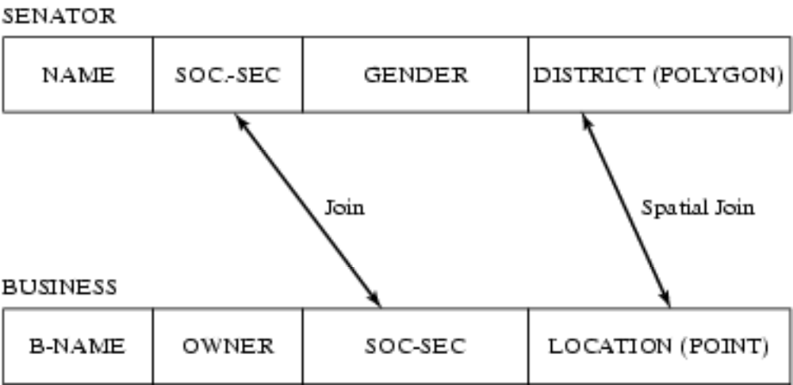
Multi-scan Query Example
Spatial join example
  SELECT S.name FROM Senator S, Business B
WHERE S.district.Area() > 300 AND Within(B.location, S.district)
Non-Spatial Join example
  SELECT S.name FROM Senator S, Business B
  WHERE S.soc-sec = B.soc-sec AND S.gender = ‘Female’
Fig 1.7

Slide 22
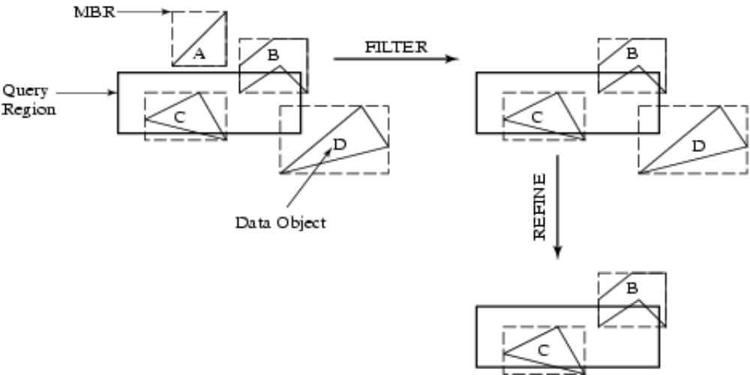
1.6.3 Query Processing
Efficient algorithms to answer spatial queries
Common Strategy - filter and refine
  Filter Step:Query Region overlaps with MBRs (Minimum Bounding Rectangle) of B,C and D
  Refine Step: Query Region overlaps with B and C
Fig 1.8

Slide 23
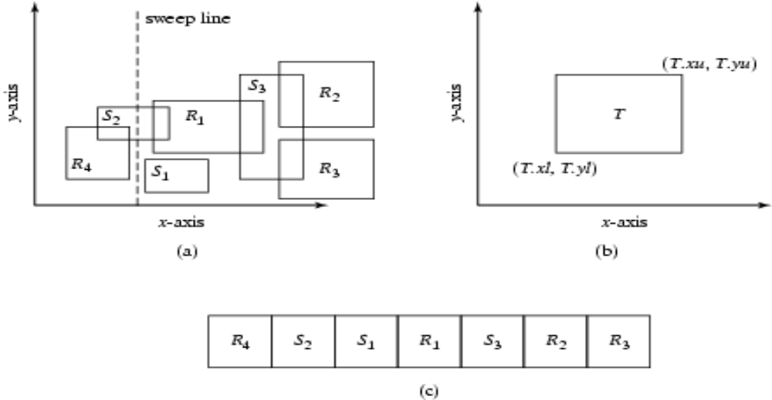
Query Processing of Join Queries
Example - Determining pairs of intersecting rectangles
  (a):Two sets R and S of rectangles, (b): A rectangle with 2 opposite corners marked, (c ): Rectangles sorted by smallest X coordinate value
  Plane sweep filter identifies 5 pairs out of 12 for refinement step
  Details of plane sweep algorithm on page 15
Fig 1.9

Slide 24
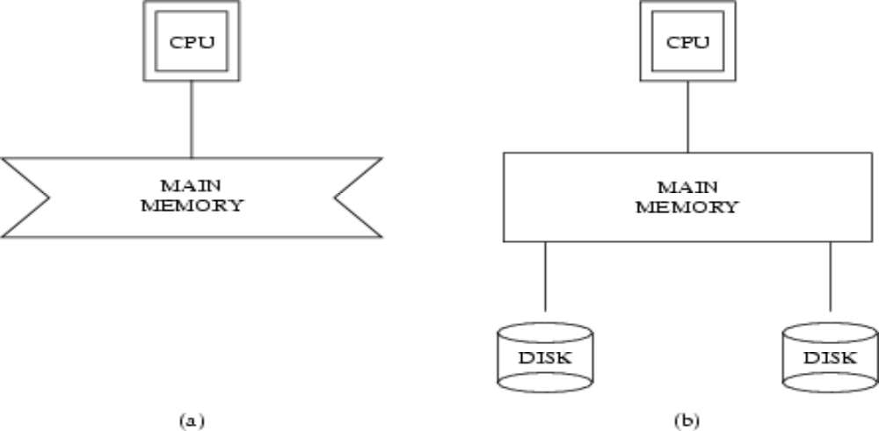
1.6.4 File Organization and Indices
A difference between GIS and SDBMS assumptions
  GIS algorithms: dataset is loaded in main memory (Fig. 1.10(a))
  SDBMS: dataset is on secondary storage e.g disk (Fig. 1.10(b))
  SDBMS uses space filling curves and spatial indices
    to efficiently search disk resident large spatial datasets
Fig 1.10

Slide 25
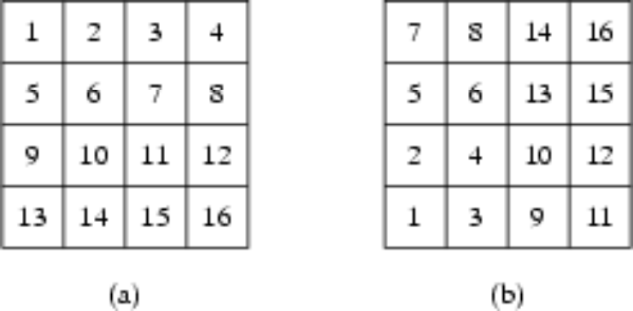
Organizing spatial data with space filling curves
Issue:
  Sorting is not naturally defined on spatial data
  Many efficient search methods are based on sorting datasets
Space filling curves
  Impose an ordering on the locations in a multi-dimensional space
  Examples: row-order (Fig. 1.11(a), z-order (Fig 1.11(b))
  Allow use of traditional efficient search methods on spatial data
Fig 1.11

Slide 26
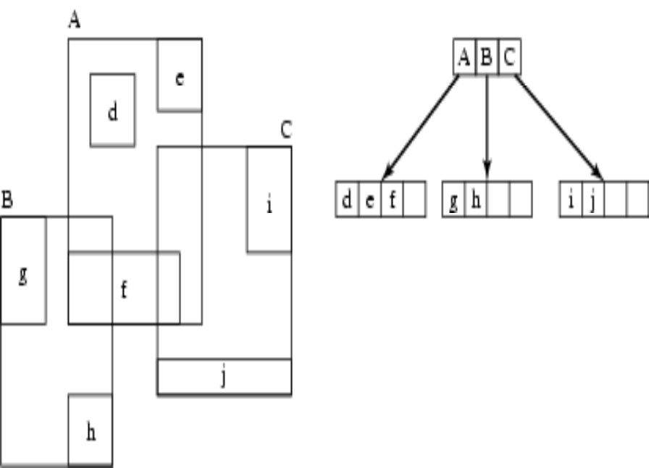
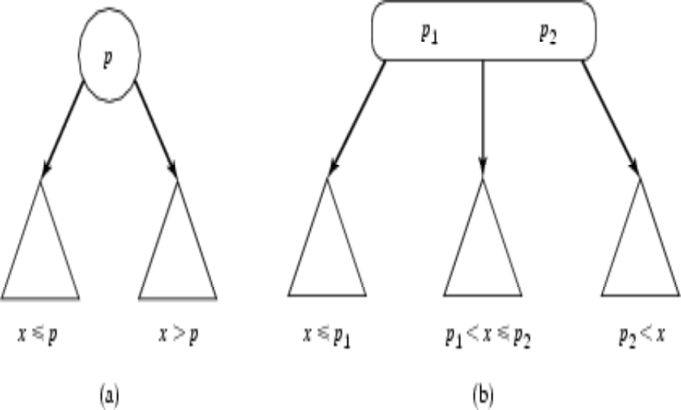
Spatial Indexing: Search Data-Structures
Choice for spatial indexing:
  B-tree is a hierarchical collection of ranges of linear keys, e.g. numbers
  B-tree index is used for efficient search of traditional data
  B-tree can be used with space filling curve on spatial data
  R-tree provides better search performance yet!
  R-tree is a hierarchical collection of rectangles
Fig 1.12: B-tree
Fig. 1.13: R- tree

Slide 27
1.6.5 Query Optimization
Query Optimization
  A spatial operation can be processed using different strategies
  Computation cost of each strategy depends on many parameters
  Query optimization is the process of
    ordering operations in a query and
    selecting efficient strategy for each operation
    based on the details of a given dataset
Example Query:
  SELECT S.name FROM Senator S, Business B
  WHERE S.soc-sec = B.soc-sec AND S.gender = ‘Female’
Optimization decision examples
  Process (S.gender = ‘Female’) before (S.soc-sec = B.soc-sec )
  Do not use index for processing (S.gender = ‘Female’)

Slide 28
1.6.6 Data Mining
Analysis of spatial data is of many types
  Deductive Querying, e.g. searching, sorting, overlays
  Inductive Mining, e.g. statistics, correlation, clustering,classification, …
Data mining is a systematic and semi-automated search for interesting non-trivial patterns in large spatial databases
Example applications include
  Infer land-use classification from satellite imagery
  Identify cancer clusters and geographic factors with high correlation
  Identify crime hotspots to assign police patrols and social workers

Slide 29
1.7. Kiến trúc của SDBMS
Theo kiến trúc 3 tầng (three layer):
  Interface to spatial application
  Core spatial functionality
  Interface to DBMS
Core Spatial Functionality
Taxonomy
Data types
Operations
Query language
Algorithms
Access methods
Interface to spatial application
DBMS
Spatial application
Interface to DBMS

Slide 30
1.7. Các hệ quản trị CSDL không gian
Access
SQL Server
MySQL
Oracle
PostgreSQL - PostGIS

